Slide 1
Insurance Claims Workshop
Financial Lines Claims
Loss Scenarios & Claims Adjustments
Part One
Causes & Trend
By: Uzair Mirza

Slide 2
Crime
Financial Institutions particularly banks are exposed to a variety of crimes ranging from very crude hold-ups/robberies to complex frauds and forgeries
Result – Financial Loss, Litigations, Bad Press etc.

Slide 3
Crude Crime
Robberies
Hold-ups (Dacoity)
Theft
Generally Violent
Single Attempt
Immediately known
Think

Slide 4
Complex Crimes
Counterfeiting
Forgery
Embezzlement
Computer Fraud
Plastic Card Frauds
Non-Violent
Multiple Attempts
Generally Not Immediately Known
Think

Slide 5
Key Difference
Crude Crime – Loss quantum is known immediately with certainty
Complex (White Collar) Crimes – establishing Loss quantum is not easy and time consuming; generally speaking

Slide 6
Types of Crime
  Crude / Violent Crimes
    Small amounts (few thousand rupees) to very large bank heists involving hundreds of millions rupees.
    During Business Hours
    Off Business Hours
    Simple show of weapon to actual shooting spree
    Couple of minutes to overnight stay in bank premises
    Totally fortuitous without any inside assistance and/or information
    Insider’s initiated and/or assisted assault

Slide 7
Types of Crime
  Complex Crimes
    Rarely involve small amounts; generally bigger than average robbery claim
    Generally perpetrated by an insider (Employee) alone or in connivance with an outsider
    Not very often also by someone well versed with “loop holes” in internal control if not assisted or connived by an insider
    Generally multiple incidents where an employee or a well versed outsider involved
    Most common cause of third party fraud is breach of SoPs and guidelines

Slide 8
Key Factors
MACRO
Both type of Crimes have roots in
  Condition of Economy
  Political / Law & Order Situation
MICRO
  Branch Network
  Physical Security
  Operational Controls

Slide 9
Macro Factors
Criminologists tend to say that tough economic times lead to more property crimes and robberies.
Economists tend to argue the opposite, that better economic times increase crime.
Both Correct

Slide 10
Both Correct
Crude and violent Crime generally on the rise during the periods of economic distress coupled with political instability and deteriorated law and order
Incidents of Frauds and forgeries increase during periods economic growth but not-that-effective law enforcement

Slide 11
Macro Factors
Crime is episodic and there is no singular effect of the economy on crime. It is necessary to understand what type of period we are in.
The presence of gangs, weapons availability, the availability and level of protection of potential targets etc., and the effectiveness of law enforcement activity all play a significant role in enabling or restraining overall crime levels.

Slide 12
Macro Factors
Further criminological factors such as
  shift from ‘traditional’ property crimes to new types of acquisitive crime such as computer fraud,
  the impact of government policy aimed at reducing crime.
  complex interplay of gradually changing socio-economic factors.

Slide 13
Macro Factors
There is a lag time between changes in the economic variable and resultant impact on crime levels. The average lag time could vary from couple of months to years.

Slide 14
Micro Factors
  Branch Network
  Financial Institutions with extended branch networks are more exposed to violent crimes and frauds
  Physical Security
  Less Security – More Chances of Crime
  Operational Controls
  Most Important in restraining Frauds and Complex Crimes

Slide 15
Internal Control
The word CRIME is an acronym for internal control components:
  Control
    Policies and procedures
    proper segregation of duties,
    safeguarded computer systems,
    proper review and approval process etc.
  Risk
    periodic identification and assessment of risk arising from both internal and external sources,
    Formulation and implementation of processes to minimize identified risks.

Slide 16
Internal Control
  Information Systems
    procedures for capturing and communicating critical data effectively to designated employees,
    ensuring good password and other computer security processes
    authorization procedures, etc.
  Monitoring
    continual process of evaluating, assessing and updating the systems of internal controls for ensuring consistent application of procedures .
  Environment
    corporate culture setting and promoting a zero tolerance policy for abused or misused internal controls .

Slide 17
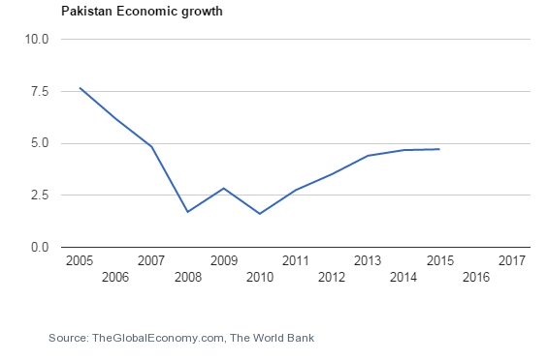
Pakistan Economic Growth

Slide 18
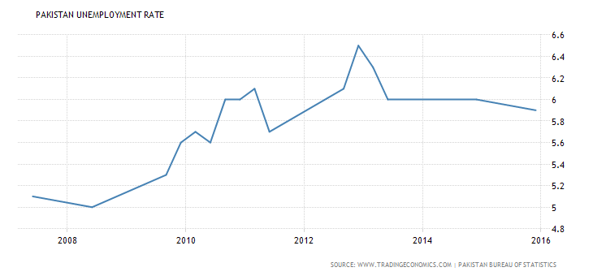
Pakistan Unemployment Rate

Slide 19
Average Loss Size - Crude Crime

Slide 20
Average Loss Size - Employee Fraud

Slide 21
Average Loss Size - Other Frauds

Slide 22
Average Loss Size - All Types

Slide 23
Year Wise Number of Incidents Composition

Slide 24
Year Wise Loss Amount Composition

Slide 26
Financial Lines
Part 2: Continued
By:
Khurram Nasim Ghuman

Slide 27
Financial Lines
“Financial Lines” stands for insurance products covering financial loss and costs thereof.
Financial Loss means loss which is neither personal nor property damage nor derived from such damages.

Slide 28
Current Active Financial Lines Products Here
Bankers Blanket Bond
Electronic & Computer Crime Insurance
Lockers Insurance ~ Banks’ Legal Liability Cover
Plastic Card Insurance
Financial Institution Professional Indemnity Insurance
D&O Liability Insurance

Slide 29
Insurance Offerings
The insurance market offers various policies, on named perils basis, and has demonstrated willingness to innovate and add new policies in line with the changing needs of Financial Institutions
BBB
ECC
SDB
FIPI
D&O

Slide 30
Financial Lines Products
First party loss
(direct financial loss sustained by the policyholder)

Slide 31
Losses Discovered / Claims Made
Direct Financial Loss:
Discovered or First Made during policy period
AND
Sustained after the Retroactive Date
Policy responds to the date of Discovery and not date of Occurrence

Slide 32
What is at Risk?
PROPERTY
Cash
Bullion, Precious metals, Stones gems etc.
Cheques, Payorders, DD
Share Certificates, Title Deeds, Bonds etc. etc.,
Electronic & Computer Fund Transfer Instructions,
Electronic Securities
Customer Property in Safe Deposit Lockers

Slide 33
Who Can Risk the Property?
Insiders
  Dishonest Employees
Outsiders
  Robbers,
  Burglars,
  Thieves,
  False Pretenders
  Fraudsters etc.,

Slide 34
Operative Clause
  Promise to make good
  Direct Financial Loss
  In excess of Deductibles
  Subject to Terms and Conditions
  Discovered During the Policy Period
  Occurred Subsequent to Retroactive Date

Slide 35
Why Do You Need BBB Insurance?
Crime is a global problem and is often an unfortunate “by product” of social advancement.
Crime is on the increase everywhere in the world and the sad fact is that many Banks/Financial Institutions have only become alerted to this as a result of a crime loss.
Because of today’s economic climate there has been a surge in armed bank raids, fraudulent transfer of funds by employees, theft of cash by employees, raids on cash in transit and increased document fraud.
EVERY FINANCIAL INSTITUTION IS VULNERABLE !

Slide 36
BBB Policy Composition
Infidelity
Of
Employees
Premises
Risk
Transit
Risk
Forgery
Counterfeit
Currency
Office &
Contents
Securities

Slide 37
MAIN BBB INSURING CLAUSES
1. Infidelity
Dishonest or fraudulent acts of Employees
2. On Premises
Loss or Damage to cash and securities.
3. In Transit
Loss or damage to cash an securities in transit
4. Forgery or Alteration
Loss resulting from forgery or fraudulent alteration of banking collateral instruments; cheques, drafts, bills of exchange etc.
5. Securities
Loss resulting from the Assured acting in good faith upon Securities which prove to be counterfeit, Forged or Lost or Stolen

Slide 38
Conditions Precedent To Liability
A written and maintained Rule book of the business
Duty bifurcation from commencement to completion between employees
Joint Custody
Dual Control
Two weeks uninterrupted holiday in a calendar year
Thorough internal audit
Review of internal controls

Slide 39
Some Important Conditions
Merger or Change in Ownership or Control of Business
Other such Insurance in place
Sectional or Total aggregation of limit
Non-Cumulative Liability
Deductible/Excess
Ultimate Net Loss

Slide 40
LIMITS & DEDUCTIBLES
Insurance Premium Budget
Confidence in Risk Management & Control Process
Areas of Business Activity
Geographical Spread
Appetite for Risk
Loss History
Peer Group Limits
Availability of the Limit
Size of the Institution

Slide 41
INTERNATIONAL CAPACITY

Slide 42
UNDERWRITING CONCERNS FOR INSURERS
1. Loss history
2. Financial Status of the Bank
3. Compliance
4. Underwriting values at risk
5. Procedures & Controls
6. Physical Security
7. General description of data processing activities
8. Details of computer hardware and software
9. Details of systems, independent contractors, fund transfers and clearing operations
10. Thorough Risk Review

Slide 43
Limits/Sub-limits & Deductibles
  Overall Policy Aggregate
  BBB
    Section Aggregate Sub Limit
    Individual Clause wise Sub Limits & Deductibles
    Branch Wise Sub Limits & Deductibles
  Computer Crime
    Section Aggregate Sub Limit
    Individual Clause wise Sub Limits & Deductibles
  Lockers
    Section Per Event & Aggregate Sub Limit
    Locker Size Wise Per Event Limit

Slide 44
Few Loss Examples
Branch manager at a bank over a number of years embezzled from long term deposit accounts of elderly customers.
Total figure USD 15m
A manager at a bank used her position within the branch to set up accounts using false names and granted loans and over-drafts to them. She also embezzled from genuine customers’ accounts, by changing personal details and sending new cards / cheque books to false addresses.
Total figure USD 1m
Bank employee fraudulently transferred monies from 11 dormant accounts to offshore accounts. All traces of the accounts were wiped out to cover her tracks.
Total figure USD 4.3m

Slide 45
Loss Examples continued…
A commercial bank issued unsecured personal loans to customers on the basis of Salary Certificates and 3 months of Bank Statements. The bank began to review their loan files after a number of loan defaults and discovered that they had acted upon forged Salary Certificate letters for individuals that were not employees of the company purporting to issue the letters as well as falsified Bank Statements. The loan process had proven to be weak and no actual verification of the Salary Certificates had been conducted leaving the bank with a significant financial loss.
Total figure USD 1.75m

Slide 46
Loss Examples continued…
A bank became the target of a well organised criminal group who managed to obtain forged passports for several account holders, as well as duplicated mobile telephone SIM cards. This enabled the criminals to change sensitive account information including call-back verification numbers and then make fraudulent withdrawals from customer accounts.
Total figure USD 1.34m

Slide 47
Loss Examples continued…
A Bank had its Credit Card systems hacked by a fraud gang. The cards were all Pre-Paid Credit Cards. Once the banks’ systems were amended the fraud gang used the cards to withdraw money via various ATM machines around the world. In a 24hour period the bank had lost in excess of USD40m. Other banks have also been targeted, using a similar means to get in to the banks systems which have resulted in further losses of around USD5m. It come to light that the hackers amended the card limits and security coding which allowed the gang to get away with these large sums of money without the standard security measures being activated.
Total figure USD 45m

Slide 48
Add on Cover
Computer Crime:
Added on to a Banker's Blanket Bond Policy,
Computer Crime Insurance attempts to provide, under one insurance contract, protection for “electronic funds” against Crime Risks perpetrated by unidentified employees or other persons through the Banks/Financial Institutions computer system(s).

Slide 49
Electronic & Computer Crime
Financial Institutions have an Increasing reliance on automated systems, which led insurers to re-examine coverage and develop Electronic & Computer Crime insurance as a companion to BBB.
Whilst the Bankers‘ Blanket Bond would cover losses associated with employee fraud in the bank's automated systems, it would not cover fraud perpetrated by third parties using telecommunications links connected to the computer systems

Slide 50
Computer Crime Insuring Clauses (LSW 238)
Clause – 1 (Computer Systems)
Clause – 2 (Assured Service Bureau Operations)
Clause – 3 (Electronic Computer Instructions)
Clause – 4 (Electronic Data & Media)
Clause – 5 (Computer Virus)
Clause – 6 (Electronic Communication)
Clause – 7 (Electronic Transmission)
Clause – 8 (Electronic Securities)
Clause – 9 (Electronic Telefacimile)
Clause – 10(Voice Initiated Transfers)

Slide 51
Professional Indemnity Insurance
Protection to the institution for the legal liability to third parties for compensatory damages, claimant costs and expenses arising out of negligent acts, errors or omissions.
Activity with Significant Exposures include:
1. Corporate Finance: Mergers and Acquisitions
2. Trade Finance: Letters of Credit
3. Financial Advice
4. Asset Management
5. Stock Broking

Slide 52
Safe Deposit Lockers
(NMA 1790)
Customer Property (of intrinsic value) placed inside Lockers (inside a secured and guarded premises)
Excluding Cash and items with no commercial value

Slide 53
Cyber Risk (An Emerging Topic)
Cyber risk now ranks as one of the top enterprise wide risks facing organisations today.
Cyber-attacks, operational errors or technical failures have the ability to paralyse an organisation leading to significant financial loss, regulatory issues and lasting reputational damage.

Slide 54
Response To Cyber Risk
CYBER INSURANCE
Cyber liability insurance policies have been developed to address the first and third party impacts which can result from a cyber-incident whether malicious or accidental.
Traditional insurance policies may not respond to these new risks. They were developed to protect against physical triggers (e.g. fire, explosion, theft, flood etc.) leading to physical outcomes (e.g. property damage, bodily injury) rather than data, networks and intangible assets.

Slide 55
SCOPE OF CYBER INSURANCE
Personal data liability
Corporate data liability
Outsourcing liability
Data security liability
Data administrative investigations
Data administrative fines
Repair of the company’s reputation
Defence costs
Media content
Network interruption.

Slide 56
THANK YOU

